Slide 1
TRAFFIC SIGN RECOGNITION
Presentation by :
Shubham Jha

Slide 2
OBJECTIVE
We all know about self-driving cars like TESLA in which the passenger can fully depend on the car for traveling. But to achieve higher level of autonomous it is necessary for vehicles to understand and follow all traffic rules.
Main Idea behind the project is to create an AI model that can understand and recognize all kinds of traffic signs using Keras and Tensorflow.
In this project we made a deep neural network model that can classify traffic signs present in our dataset into different categories.

Slide 3
DATASET
For this we are using a publicly available dataset on Kaggle.
The dataset consists of more than 50,000 images of different traffic signs.
Dataset is quite varying as some of the classes have many images while some have less images
There are more than 40 classes
The German Traffic Sign Benchmark is a multi class single image classification held at (IJCNN) 2011

Slide 4


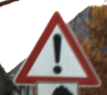




SAMPLE IMAGES FROM TRAINING SET:

Slide 5
CLASSES
Speed limit (20km/h)
Speed limit (30km/h)
Speed limit (50km/h)
Speed limit (60km/h)
Speed limit (70km/h),
Speed limit (80km/h),
End of speed limit (80km/h)
Speed limit (100km/h)
Speed limit (120km/h)
No passing
No passing veh over 3.5 tons Right-of-way at intersection
Priority road
Yield
Stop
No vehicle
Veh > 3.5 tons prohabite
No entry
General caution
Dangerous curve left
Dangerous curve right
Double curve
Bumpy road
Slippery road
Road narrows on the right
Road work
Traffic signals
Pedestrians
Children crossing
Bicycles crossing
Beware of ice/snow
Wild animals crossing
End speed + passing limits
Turn right ahead
Turn left ahead
Ahead only
Go straight or right
Go straight or left
Keep right
Keep left
Roundabout mandatory
End of no passing
End no passing veh > 3.5 tons

Slide 6
Solution
The idea is to develop a CNN model which is trained on the dataset which can classify the images in real time.

Slide 7
CNN (Convolutional neural network)
Convolutional networks are simply neural networks that use convolution in place of general matrix multiplication in at least one of their layers.
Convolution is a mathematical operation having a linear form
CNNs are regularized versions of multilayer perceptrons.
CNNs use relatively little pre-processing compared to other image classification algorithms.

Slide 8
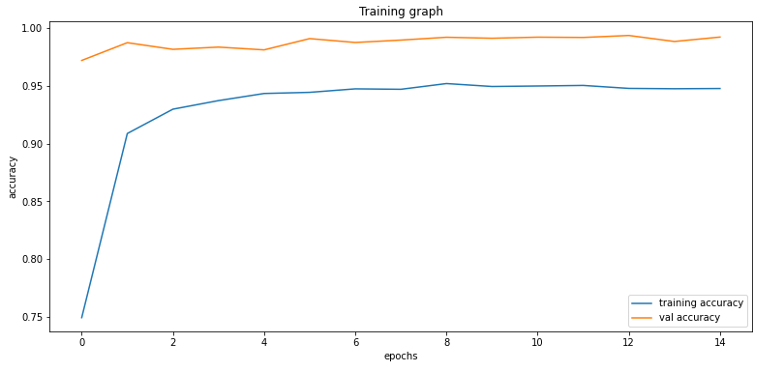
Accuracy graph for the model (training set)

Slide 9
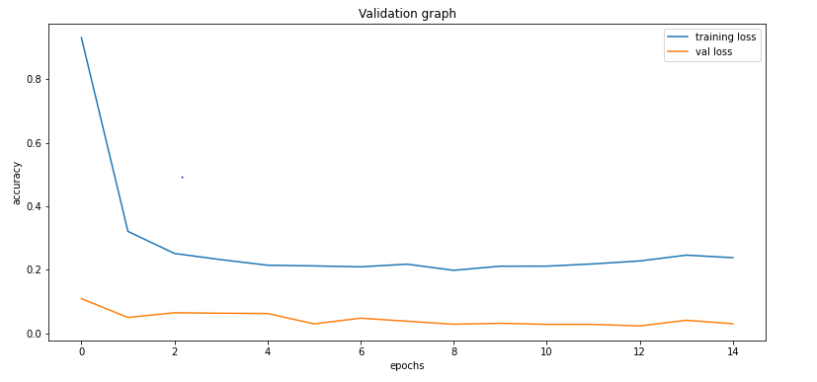
Accuracy graph for the model (testing set)

Slide 10
Conclusion
The model has an accuracy of 94% on test data.
It can be used in real time system for car navigation.
It can be used for testing purposes (like the test that we give for driving licence).

